Slide 1
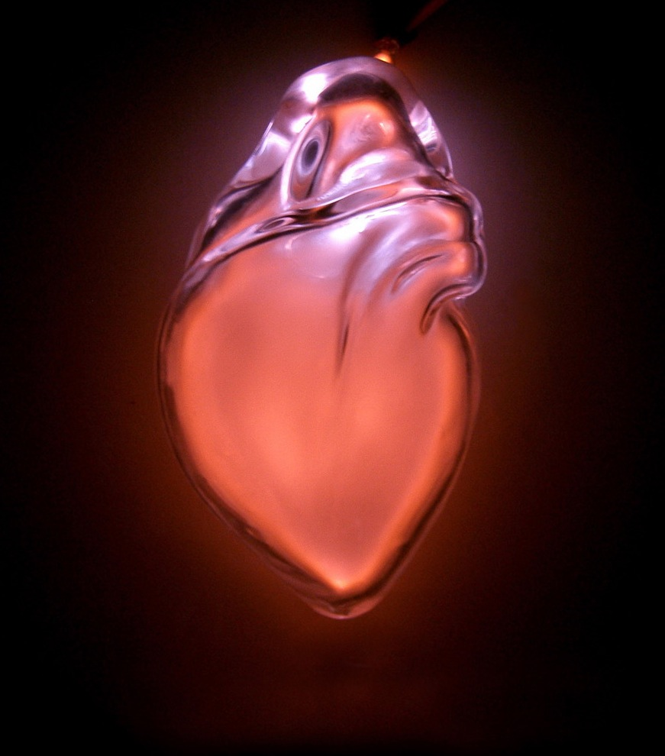
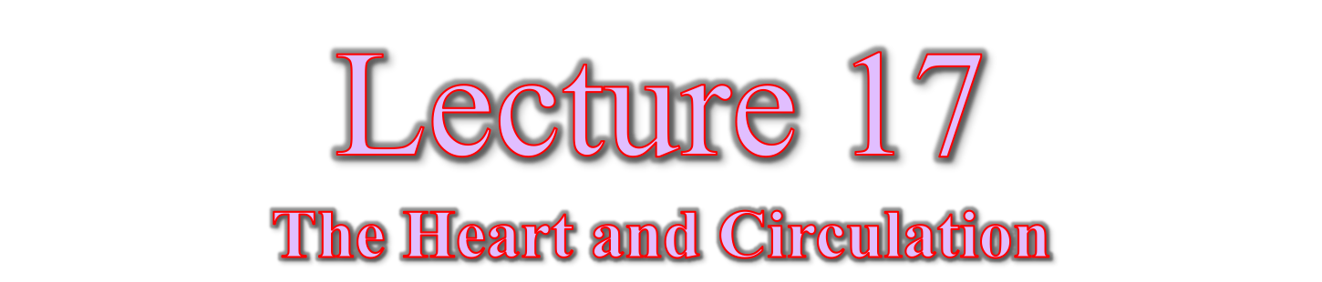

Slide 2
OVERVIEW
Transportation– how do we move things throughout our bodies?
The Nodal System – how does the heart beat without the nervous system?
Cardiac Cycle – how do the phases of a heartbeat relate to the heart’s function?
Cardiac Output – how does the heart control how much blood the body receives?
Blood Vessels – what is the unique anatomy of the blood vessels?
Circulation – how to blood vessels help the heart control blood flow?

Slide 3
THE NODAL SYSTEM
The heart contracts independently of the nervous system
  Cardiac muscle cells depolarize on their own
2 Systems regulate heart activity
  Autonomic nervous system
    Makes adjustments to rhythm
  Nodal system
    Controls heart rhythm
    Independent of the nervous system

Slide 4
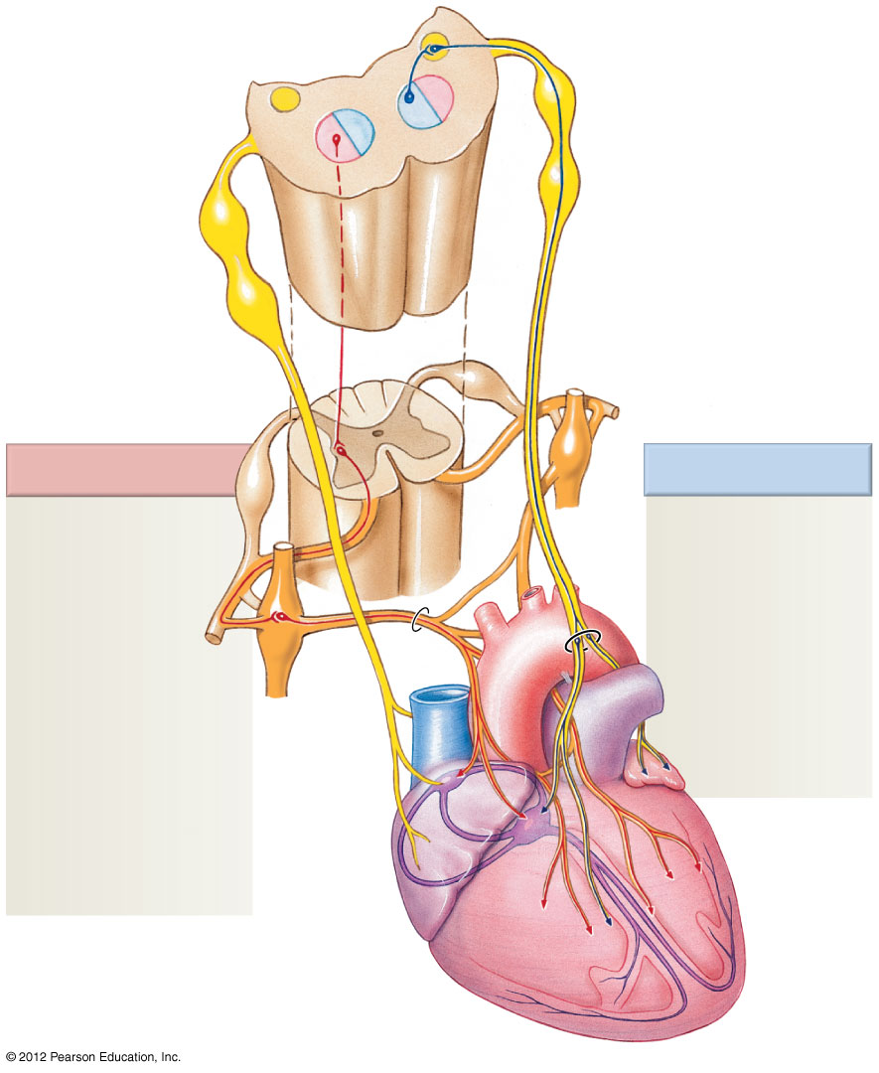
THE NODAL SYSTEM
Autonomic Control
  The sympathetic branch of the ANS:
    Increases heart rate
    Increases force of contractions
  The parasympathetic branch of the ANS:
    Decreases heart rate
    Decreases force of contractions
Sympathetic
Parasympathetic
Sympathetic fibers
INCREASE:
Heart rate
Contraction
strength
Parasympathetic
fibers DECREASE:
Heart rate
Contraction
strength

Slide 5
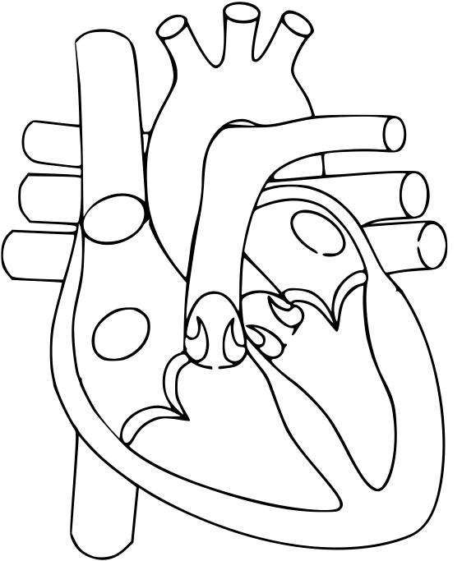
Color and label (using study notes or slides):
Nodes = Yellow
Conducting fibers = Orange
Electrical signal = Black arrows
Label all nodes
Label all fibers
Starting with the SA node as #1, indicate the order that electricity travels through the heart

Slide 6
THE NODAL SYSTEM
The Nodal System → Independent contraction
Components of the Nodal System
  Sinoatrial (SA) node
    Located in the right atrium
    Serves as the heart’s pacemaker
  Atrioventricular (AV) node
    At the junction of the atria and ventricles
  Bundle of His and bundle branches
    Within the interventricular septum
  Purkinje fibers
    Spread within the ventricle wall muscles

Slide 7
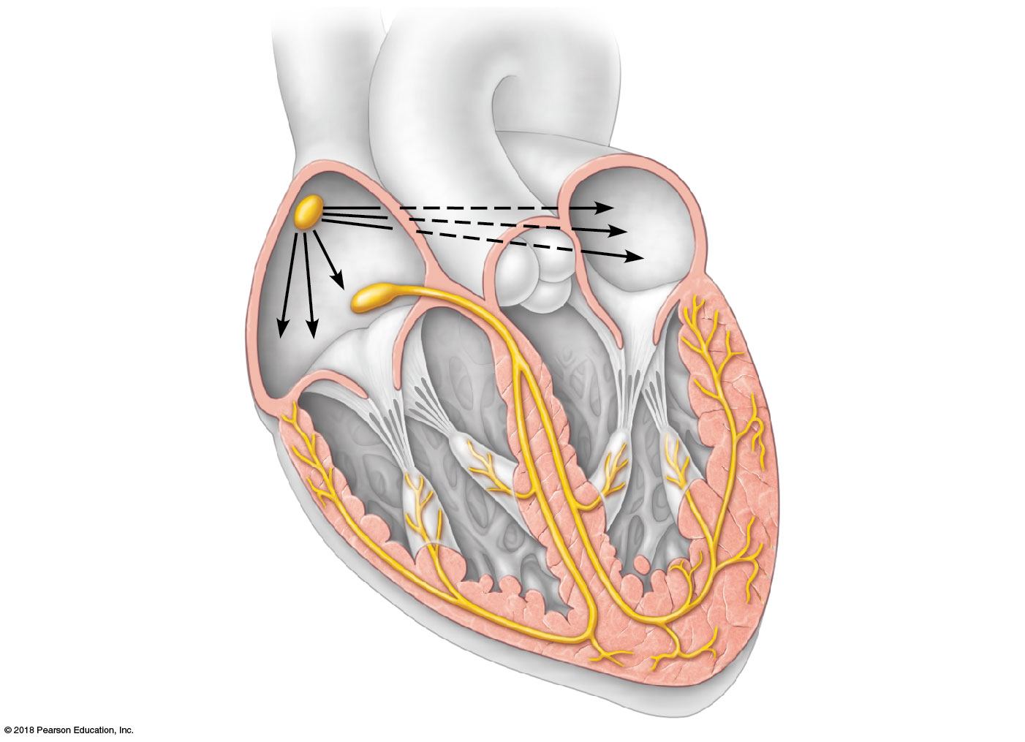
THE NODAL SYSTEM
Sinoatrial (SA)
Node
Left atrium
Atrioventricular
(AV) node
Right atrium
Bundle of His
(conducting fibers)
Bundle branches
(conducting fibers)
Purkinje fibers
(conducting fibers)
Purkinje fibers
(conducting fibers)
Interventricular
septum

Slide 8
THE NODAL SYSTEM
Contraction via the Nodal System
  The sinoatrial node (SA node) starts each heartbeat
  Impulse spreads through the atria
  Atria contract
  At the AV node, the impulse is delayed briefly to allow ventricles to fill with blood
  Impulse travels through the Bundle of His, bundle branches, and Purkinje fibers
  Ventricles contract
  Blood is ejected from the heart

Slide 9
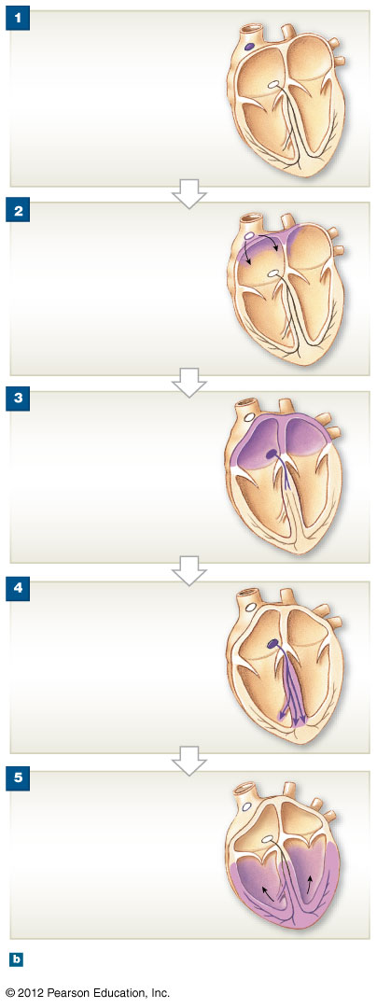
SA node
SA node depolarizes.
AV node
Electrical signal from the SA
node spreads across he atria
until it reaches the AV node.
Atrial contraction begins.
There is a slight delay
before the AV node
allows the signal to
enter the ventricles.
Bundle
of His
Bundle
branches
The impulse travels along the
interventricular septum within
the Bundle of His and the
Bundle branches to the
Purkinje fibers
The impulse is distributed by
Purkinje fibers and relayed
throughout the ventricles.
Ventricular contraction begins.
Purkinje
fibers
Notes:
9

Slide 10
Identify the SA node:

Slide 11
Identify the AV node:

Slide 12
Identify the Bundle of His:

Slide 13
Identify the Bundle Branches:

Slide 14
THE NODAL SYSTEM
Which of the following are conducting fibers?
  a. Bundle of His
  b. Bundle Branches
  c. Purkinje Fibers
  d. All of the above

Slide 15
THE NODAL SYSTEM
What do Purkinje Fibers do?
  a. Act as the first conducting fibers to receive the signal from the AV node
  b. Carry the electrical signal down the interventricular septum
  c. Distribute the electrical signal to the ventricular myocardium

Slide 16
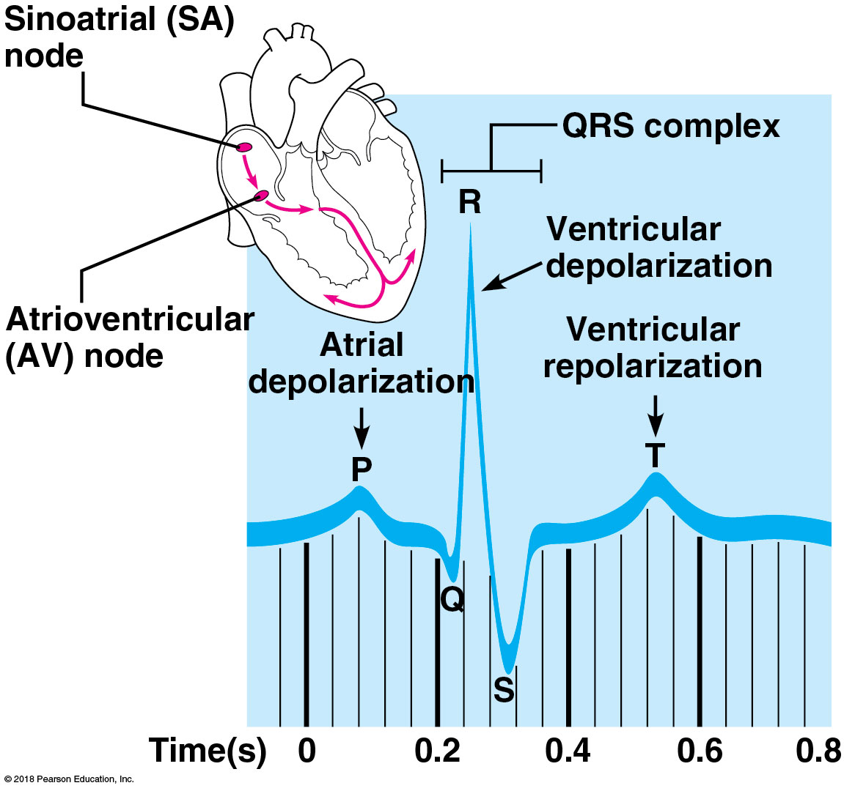
THE NODAL SYSTEM

Slide 17
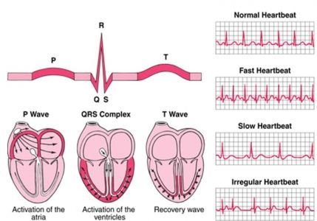
THE NODAL SYSTEM
= Sinus Rhythm
(normal)
= Tachycardia
(normal)
= Bradycardia
(normal)
= Arrhythmia
(abnormal)

Slide 18
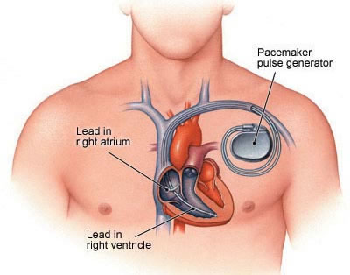
WHY DOES THIS MATTER?
Artificial pacemakers replace the sinoatrial (SA) node

Slide 19
CARDIAC CYCLE
A single heartbeat = Cardiac Cycle
  Alternating periods of contraction and relaxation
5 Phases of the Cardiac Cycle
  Atrial diastole
  Atrial systole
  Isovolumetric contraction
  Ventricular systole
  Isovolumetric relaxation

Slide 20
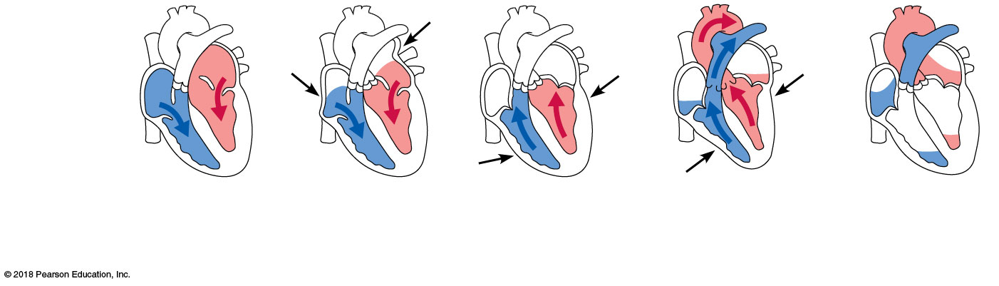
CARDIAC CYCLE
Atrial diastole
  Blood flows passively into the atria and into ventricles
  Heart is relaxed
    Pressure in heart is low
  Atrioventricular valves are open
  Semilunar valves are closed

Slide 21
CARDIAC CYCLE
Atrial systole
  Atria contract, forcing blood into the ventricles
  Ventricles remain in diastole
  Ventricles are maximally filled with blood

Slide 22
CARDIAC CYCLE
Isovolumetric contraction
  Intraventricular pressure rises in preparation for ventricular systole
    All valves are closed
    The ventricles are completely closed chambers

Slide 23
CARDIAC CYCLE
Ventricular systole
  Ventricles fully contract
    Blood is ejected from the ventricles
  Semilunar valves open
    Intraventricular pressure now surpasses the pressure in the major arteries leaving the heart
  Atria are relaxed and filling with blood
  = Systolic blood pressure

Slide 24
CARDIAC CYCLE
Isovolumetric relaxation
  Ventricles relax
  Semilunar valves close
    Pressure falls below that in the major arteries
  AV valves open
    When atrial pressure increases above intraventricular pressure, the
  = Diastolic blood pressure

Slide 25
CARDIAC CYCLE
Left atrium
Right atrium
Left ventricle
Right ventricle
1
2
3
4
5
Atrial diastole
(ventricular filling)
Atrial
systole
Isovolumetric
contraction
Ventricular
systole (ejection
phase)
Isovolumetric
relaxation

Slide 26
CARDIAC CYCLE
Heart sounds
  “Lub – Dub”, pause, “Lub – Dub”, pause…
  “Lub” heart sound caused by the closing of the AV valves during atrial systole
  “Dub” heart sound caused by the closing of the semilunar valves during ventricular systole
  Pause caused by the filling of the atria and ventricles during diastole

Slide 27
CARDIAC CYCLE

Slide 28
CARDIAC OUTPUT
Cardiac output (CO) - ml/min
  Amount of blood pumped by each ventricle in 1 minute
  CO = Force (Stroke Volume) x Rate (Heart Rate)
Stroke volume (SV) - ml/beat
  Force of heart contractions
  Volume of blood pumped by each ventricle in one contraction
  Average = 70 ml of blood out of the left ventricle with each heartbeat
Heart rate (HR) - beats/minute
  Rate of heart contractions
  Average = 75 heart beats in 1 minute

Slide 29
CARDIAC OUTPUT
Cardiac output is the product of the heart rate (HR) and the stroke volume (SV)
  CO = HR × SV
  CO = HR (75 beats/min) × SV (70 ml/beat)
  CO = 5250 ml/min = 5.25 L/min
Almost the entire blood supply of the body (6.0 L) is pumped by the heart each minute!
Cardiac output can vary
  Increases with increased SV or HR
  Decreases with decreased SV or HR

Slide 30
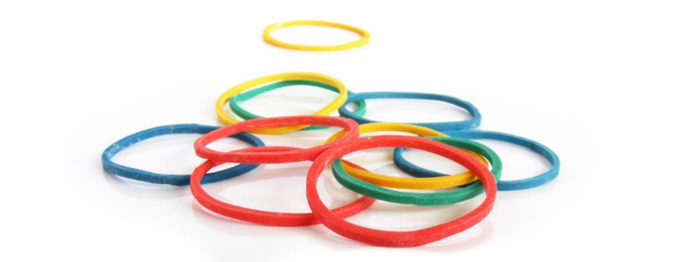
CARDIAC OUTPUT
Modification of stroke volume
  SV is controlled by how much cardiac muscle is stretched
    The more the cardiac muscle is stretched, the stronger the contraction
  Venous return is the most important factor influencing how much the heart stretches
    Venous return = Amount of deoxygenated blood returning from the body and entering the heart

Slide 31
WHY DOES THIS MATTER?
HR increases with blood loss, dehydration, and heart disease
HR increases when SV decreases to maintain cardiac output and homeostasis
  CO = HR (75 beats/min) × SV (70 ml/beat) = 5.25 L/min
  OR
  CO = HR (105 beats/min) × SV (50 ml/beat) = 5.25 L/min

Slide 32
CARDIAC OUTPUT Practice
100 milliliters of
If the left ventricle ejects
blood per beat
60 beats per
at a rate of
minute
, how many
milliliters of blood are
pumped to the body in 1 minute?
CO = SV (100 ml/beat) x HR (60 beats/min) = 6,000 ml/min
What is STROKE VOLUME?
What is HEART RATE?
What are the units for CARDIAC OUTPUT?

Slide 33
CARDIAC OUTPUT Practice
Given a volume of
120 ml at the end of
diastole, a volume of 50 ml at the end of systole,
80 beats per
at a rate of
minute
, how
many
milliliters of blood are pumped to the
body in 1 minute?
CO = SV (70 ml/beat) x HR (80 beats/min) = 5,600 ml/min
What is STROKE VOLUME?
Diastolic blood (120 ml) – Systolic blood (50 ml) = 70 ml/beat
What is HEART RATE?
What are the units for CARDIAC OUTPUT?

Slide 34
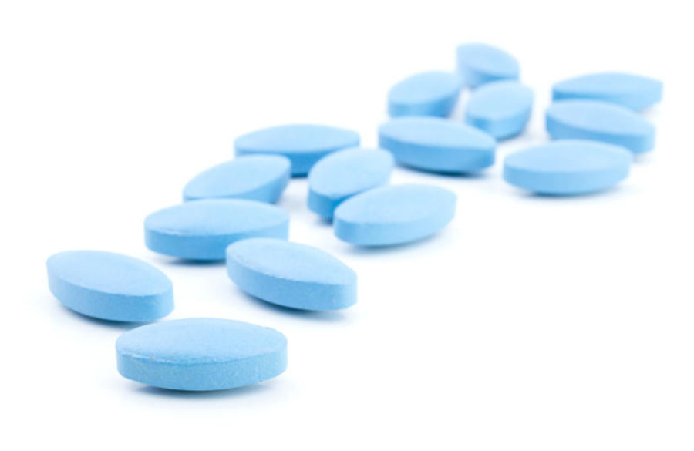
WHY DOES THIS MATTER?
Congestive Heart Failure (CHF)
  Weakening of the heart → Decreased stroke volume
  Heart rate cannot compensate → Decreased cardiac output
  CAUSES:
    Atherosclerosis (clogged vessels)
    High blood pressure
    Myocardial damage from heart attacks
    Anything that weakens the heart muscle and decreases SV
  Drugs to treat CHF increase stroke volume

Slide 35
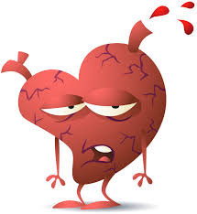
CARDIAC OUTPUT
Left-sided CHF
  Blood is not pumped OUT of the left heart
  Blood backs up from where it came from – the LUNGS
  → Coughing
Right-sided CHF
  Blood is not pumped out of the right heart
  Blood backs up from where it came from – the BODY
  → Swollen feet, ankles, and fingers
One-sided heart failure will eventually cause the whole heart to fail

Slide 36
CARDIAC OUTPUT
What kind of heart rate would you expect to see in a patient with congestive heart failure?
  a. An increased heart rate
  b. A decreased heart rate
  c. No change in heart rate

Slide 37
CARDIAC OUTPUT
What do we want the blood vessels to do in a patient with heart failure?
  a. Constrict them
  b. Dilate them
  c. Not do anything to them

Slide 38
CARDIAC OUTPUT
What do we want the kidneys to do in patients with heart failure?
  a. Get rid of extra fluid
  b. Keep as much fluid as possible
  c. Don’t worry about fluid

Slide 39
BLOOD VESSELS
Blood vessels form a closed system that transports blood to the tissues and back to the heart
  Vessels that carry blood away from the heart and towards capillaries:
    Arteries and arterioles
  Vessels that return blood toward the heart and away from capillaries:
    Venules and veins
  Vessels that play a role in exchanges between tissues and blood:
    Capillaries

Slide 40
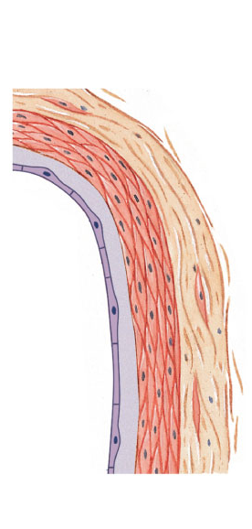
BLOOD VESSELS
3 Layers of Blood Vessels
  Tunica intima
    Inner layer
    Epithelium – Endothelium
    Forms a friction-reducing lining
  Tunica media
    Middle layer
    Smooth muscle
    Controlled by the ANS
  Tunica externa
    Outer layer
    Connective tissue
    Supports and protects the vessel
  Lumen = The inside space of a tubular structure
Externa
Media
Intima
LUMEN
Endothelium

Slide 41
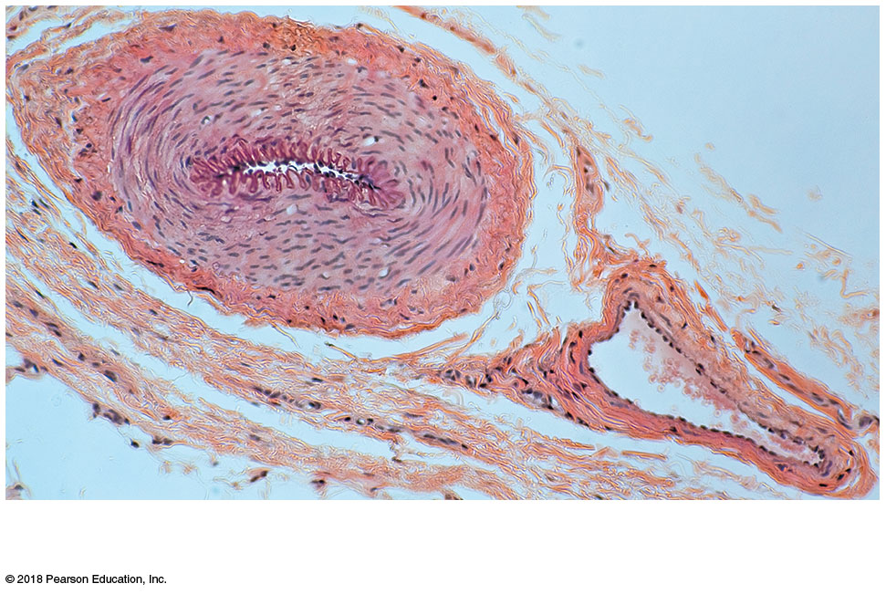
BLOOD VESSELS
Artery
Vein

Slide 42
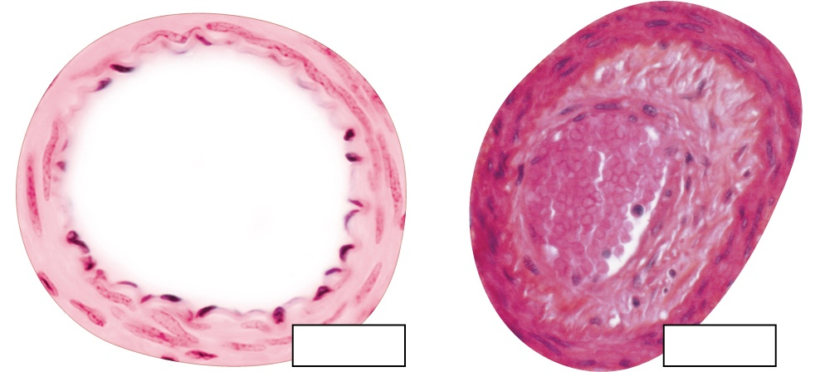
BLOOD VESSELS
Atherosclerosis = An artery narrowed by fat deposits
  Raise blood pressure
  Obstruct blood flow
  Rupture and form clots
Blood in
narrowed
lumen
Lumen
Atheroma
occluding
lumen
LM 20x
LM 50x
Normal artery
Atherosclerotic artery

Slide 43
BLOOD VESSELS
Aneurysm = An artery with weakened walls
  Rupture can be fatal

Slide 44
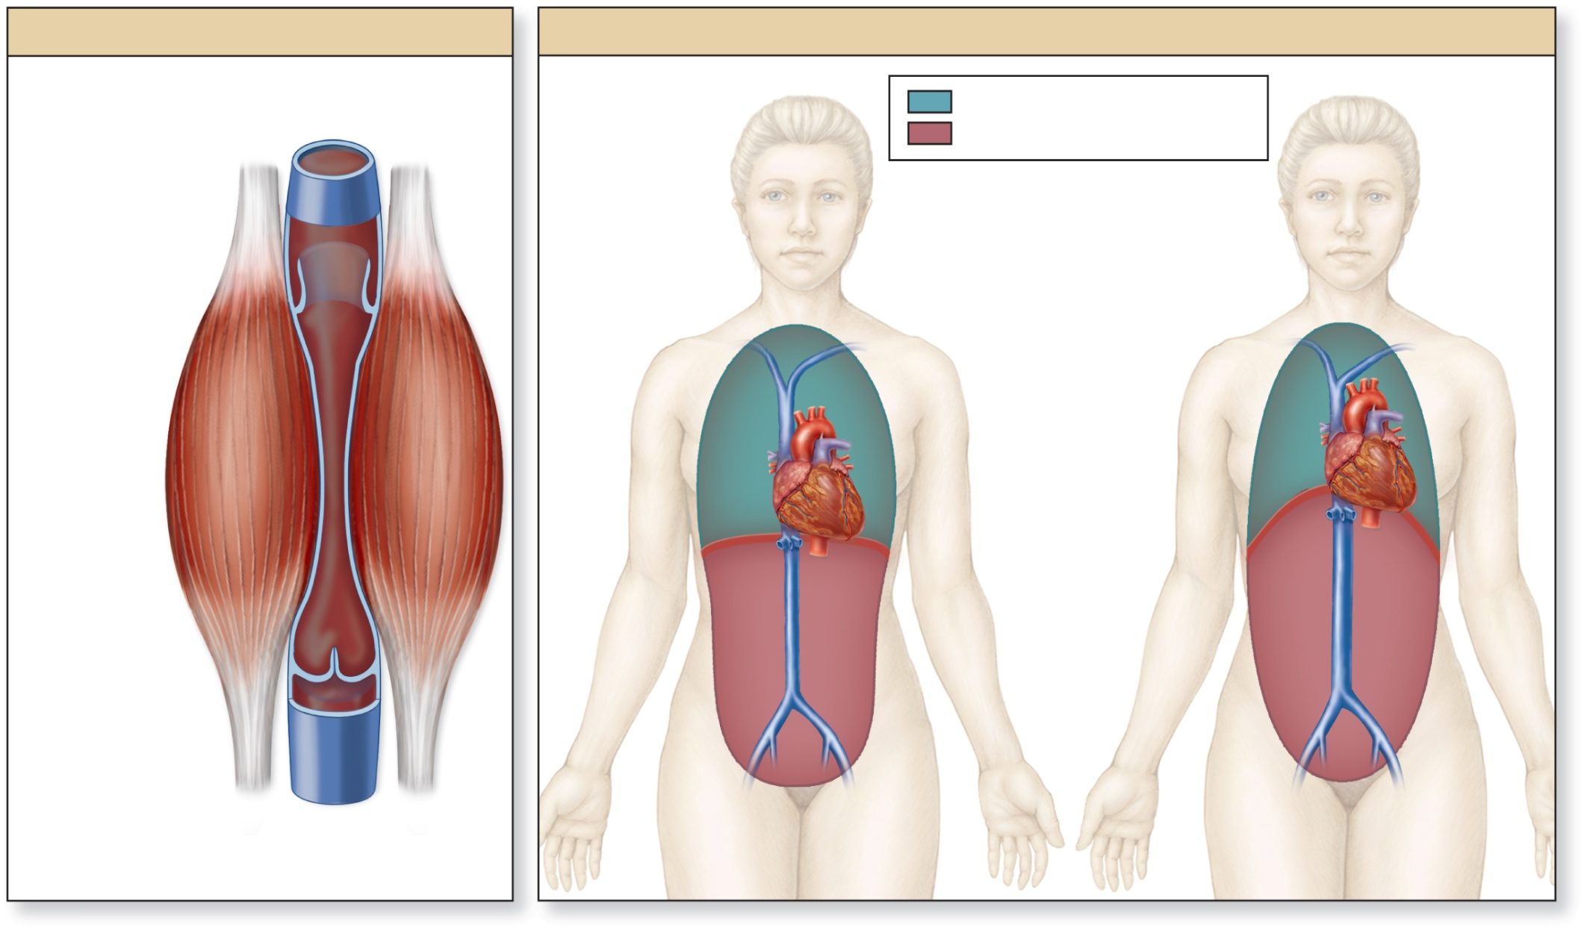
BLOOD VESSELS
Skeletal muscle pump
Respiratory pump
To heart
Thoracic cavity
Abdominopelvic cavity
Inhalation
Increases
blood flow into
thoracic
veins
Exhalation
Increases blood
flow into heart
and abdominal
veins
Increased
pressure
opens valve
Decreased
intrathoracic
pressure
Increased
intrathoracic
pressure
Contracted
skeletal
muscles
Diaphragm
contracts
Diaphragm
relaxes
Valve closed
(to prevent
blood backflow)
Blood
moves
superiorly
Compression
Release of
compression
Decreased
intra-abdominal
pressure
Increased
intra-abdominal
pressure
Vein
Blood flow
from tissues

Slide 45
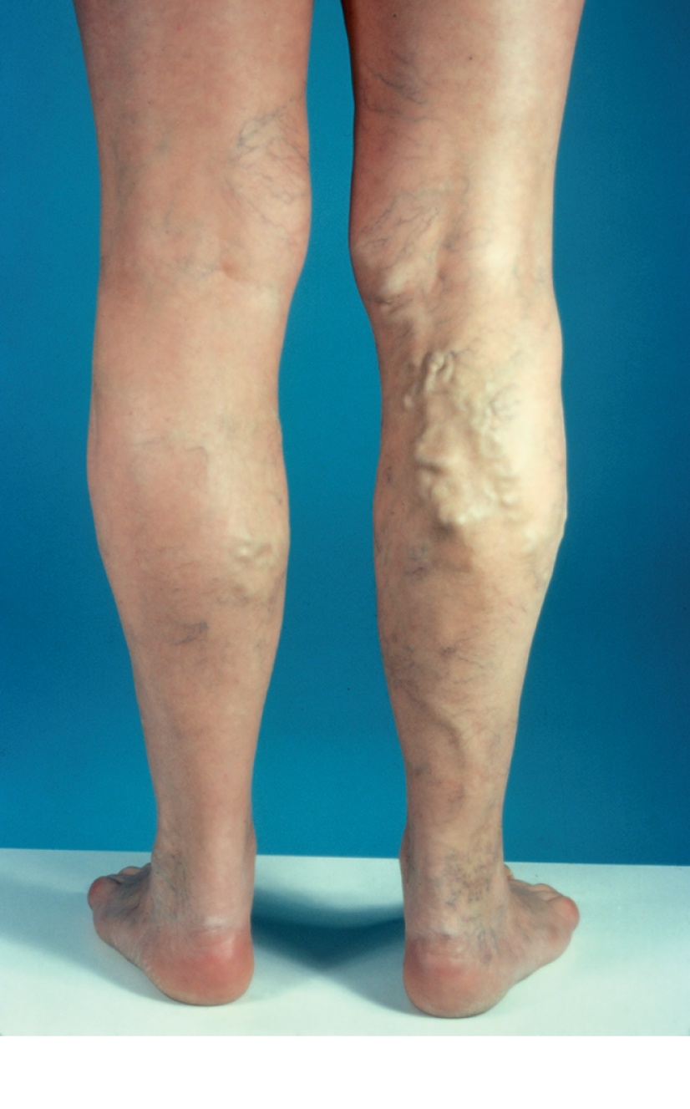
BLOOD VESSELS
Varicose veins = Veins with non-functional valves
  NOT fatal
  Occur due to age, genetics, or stress on the venous system
Varicose veins

Slide 46
BLOOD VESSELS
Arteries
  Carry blood AWAY from the heart
    Pulmonary circuit: Towards the lungs for oxygenation
    Systemic circuit: Towards cells to deliver oxygen
  Carry blood TOWARDS capillaries
  High pressure
3 Types
  Elastic arteries
  Muscular arteries
  Arterioles – give blood to capillaries

Slide 47
BLOOD VESSELS
Veins
  Carry blood TOWARDS from the heart
  Carry blood AWAY from capillaries
  Low pressure
2 Types
  Venules – drain capillaries
  Veins
Arteries and veins are almost always paired

Slide 48
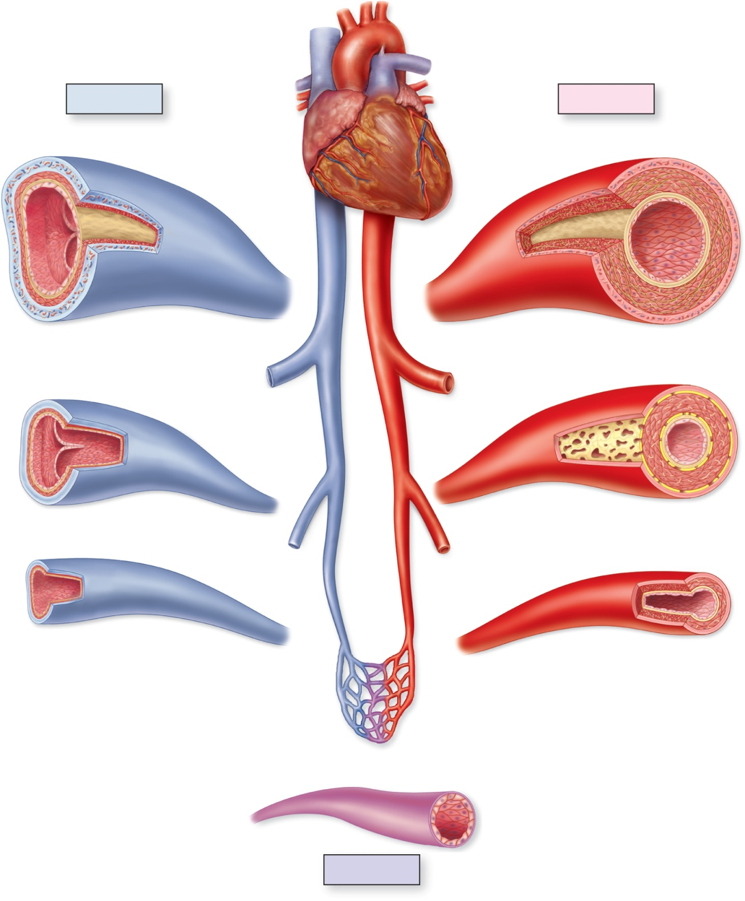
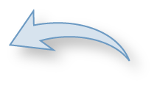
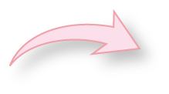
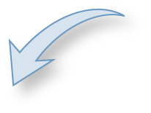
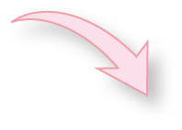
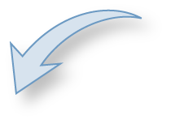
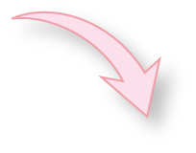

Aorta
Superior
vena cava
Pulmonary trunk
Veins
Arteries
Large vein
Elastic artery
Tunica intima
Inferior
vena cava
Valve
Tunica intima
Tunica media
Tunica media
Tunica externa
Tunica externa
Aorta
Small to medium-
sized vein
Muscular artery
Tunica intima
Tunica intima
Valve
Tunica media
Tunica media
Tunica externa
Tunica externa
Venule
Arteriole
Tunica intima
Tunica intima
Tunica media
Tunica media
Tunica externa
Tunica externa
Endothelium
Capillary

Slide 49
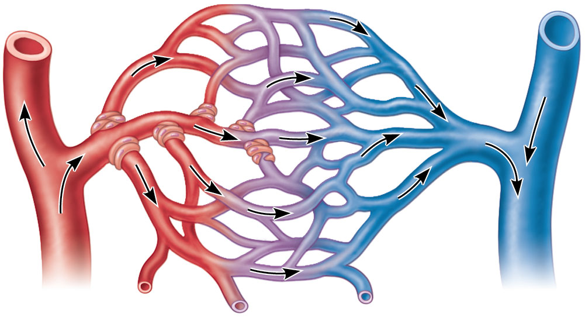
BLOOD VESSELS
Capillaries
  Where blood and cells interact
  Arteries → Veins
  High pressure → Low pressure
Cells in a tissue or organ
Arteriole
Venule
Capillary beds in tissue

Slide 50
BLOOD VESSELS
Substances move to and from the blood and tissue cells through capillary walls
  Interstitial fluid = Tissue fluid
Exchange is due to concentration gradients
  All substances move from HIGH to LOW concentrations
  Oxygen leaves the blood and move into cells
    Blood = High concentration of oxygen
    Cells = Low concentration of oxygen
  Carbon dioxide and other wastes exit cells and enter the blood
    Blood = Low concentration of waste
    Cells = High concentration of waste

Slide 51
BLOOD VESSELS
Oxygen (O₂) moves OUT of capillaries and INTO cells based on its concentration gradient
O₂
O₂
O₂
O₂
O₂
O₂
O₂
O₂
O₂
O₂
O₂
O₂
O₂
O₂
O₂

Slide 52
BLOOD VESSELS
Carbon Dioxide (CO₂) moves INTO of capillaries and OUT of cells based on its concentration gradient
CO₂
CO₂
CO₂
CO₂
CO₂
CO₂

Slide 53
BLOOD VESSELS
Fluid movement in or out of a capillary depends on 2 pressures:
  ​Blood pressure
    Forces plasma and solutes out of capillaries
  ​Osmotic pressure
    Draws plasma into capillaries

Slide 54
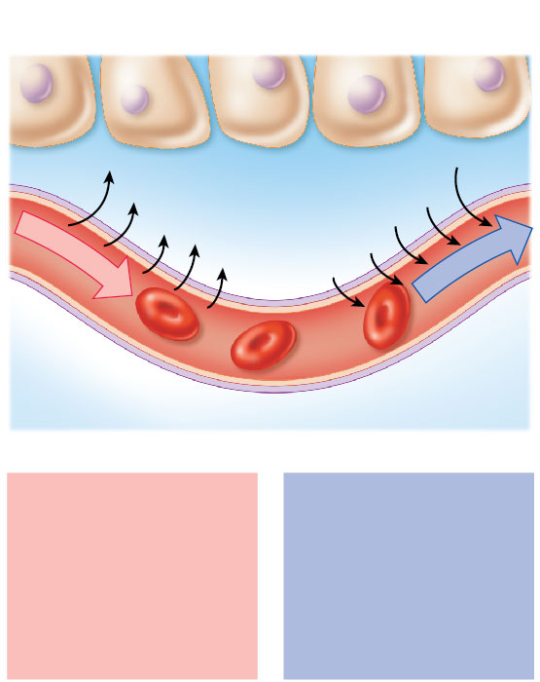


BLOOD VESSELS
In the arterial side of a capillary: Blood Pressure >> Osmotic Pressure
In the venous side of a capillary: Osmotic Pressure >> Blood Pressure
Plasma moves out of the capillary at the beginning (arterial) part
Plasma moves back in at the opposite (venous) end
Tissue cell
Interstitial fluid
Net fluid
movement
out
Net fluid
movement
in
Arterial
end of
capillary
Venule
end of
capillary
At the arterial end of a
capillary, blood
pressure is more than
osmotic pressure, and
fluid flows out of the
capillary and into the
interstitial fluid.
At the venule end of
the capillary, blood
pressure is less than
osmotic pressure, and
fluid flows from the
interstitial fluid into
the capillary.

Slide 55
BLOOD VESSELS
  Plasma moves out of the capillary at the beginning
    Due to high blood pressure in the arteriole
  Most plasma is pulled back into the capillary at the end
    Due to the pull exerted by osmotic pressure in the venule
  interstitial fluid
Arteriole
Capillary beds in tissue
Venule

Slide 56
Which region of the capillary bed has high blood pressure?

Slide 57
Which region of the capillary bed is controlled by osmotic pressure?

Slide 58
BLOOD VESSELS
Which of the following accurately predicts what happens at the arterial side of the capillary bed?
  a. Plasma is pushed out by high blood pressure
  b. Plasma is pulled back in by high blood pressure
  c. Plasma is pushed out by high osmotic pressure
  d. Plasma is pulled back in by high osmotic pressure

Slide 59
BLOOD VESSELS
Which of the following accurately predicts what happens at the venous side of the capillary bed?
  a. Plasma is pushed out by high blood pressure
  b. Plasma is pulled back in by high blood pressure
  c. Plasma is pushed out by high osmotic pressure
  d. Plasma is pulled back in by high osmotic pressure

Slide 60
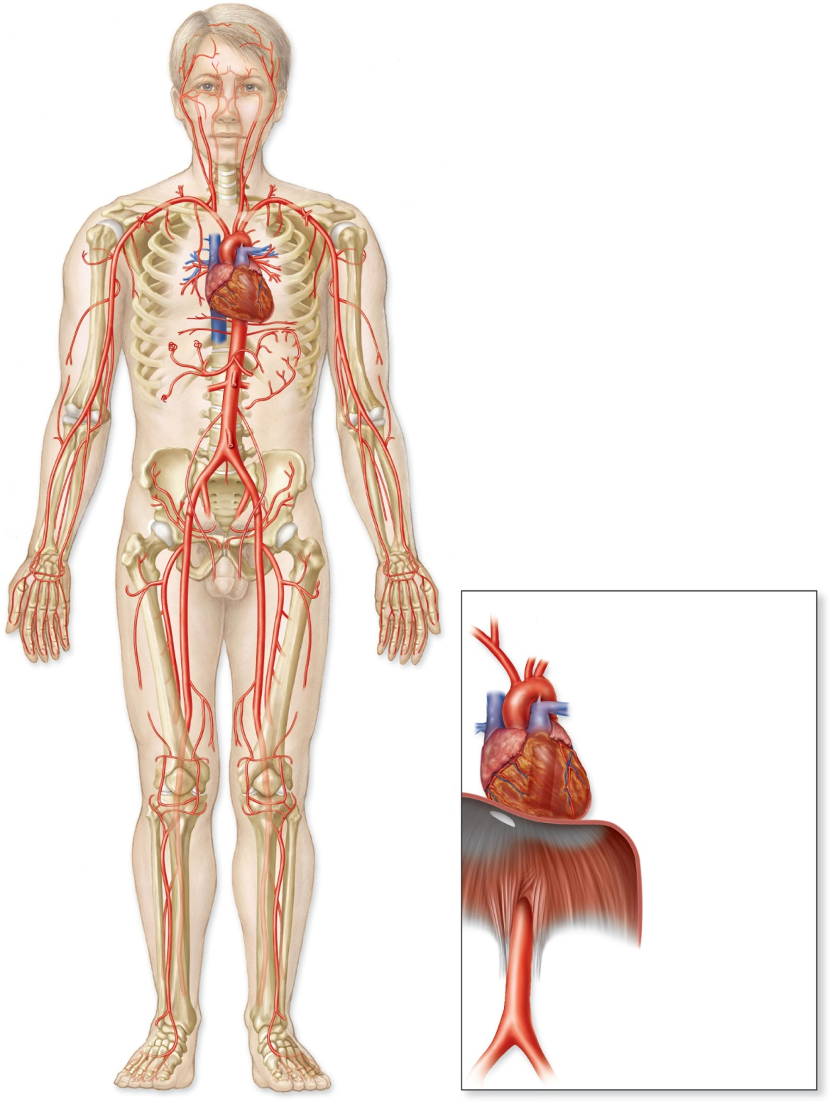
External carotid artery
Right common carotid artery
Internal carotid artery
Left common carotid artery
Right subclavian artery
Left subclavian artery
Brachiocephalic trunk
Aortic arch
Axillary artery
Ascending aorta
Brachial artery
Descending abdominal aorta
Celiac trunk
Renal artery
Common iliac artery
Right subclavian artery
Right common carotid artery
Left common carotid artery
Left subclavian artery
Femoral artery
Brachiocephalic trunk
Aortic arch
Ascending aorta
Left coronary artery
Right coronary artery
Diaphragm
Descending abdominal
aorta
Right common iliac artery
Left common iliac artery
Arteries, anterior view

Slide 61
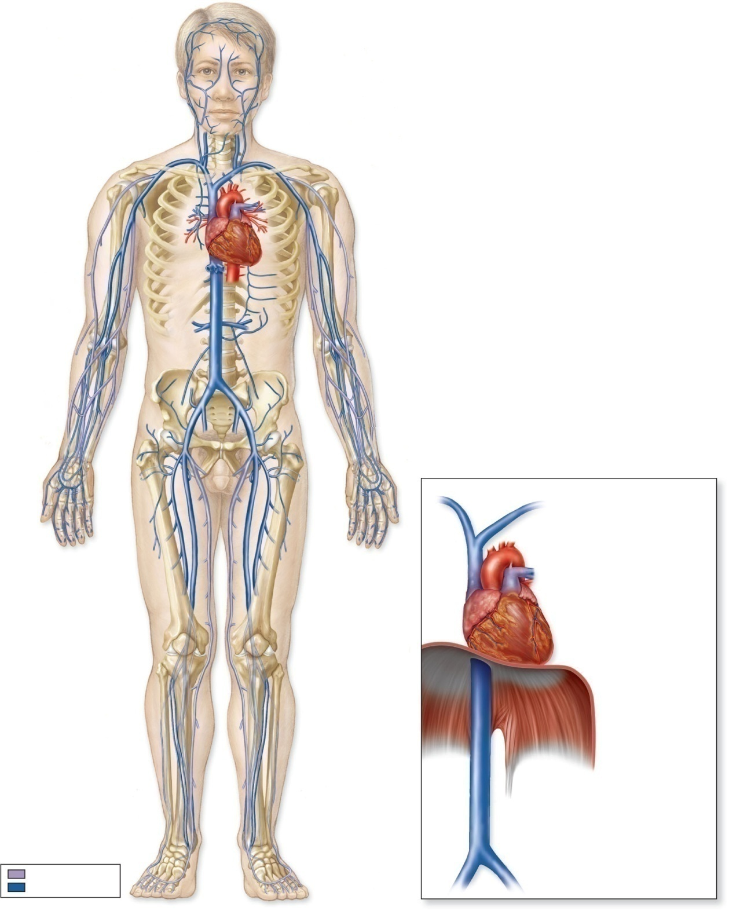
Left external jugular vein
Right subclavian vein
Left internal jugular vein
Right brachiocephalic vein
Left subclavian vein
Left brachiocephalic vein
Axillary vein
Superior vena cava
Brachial veins
Hepatic veins
Cephalic vein
Median cubital vein
Renal vein
Inferior vena cava
Common iliac vein
Right brachiocephalic vein
Left brachiocephalic vein
Femoral vein
Superior vena cava
Right atrium
Diaphragm
Inferior vena cava
Right common iliac vein
Superficial veins
Left common iliac vein
Deep veins
Veins, anterior view

Slide 62
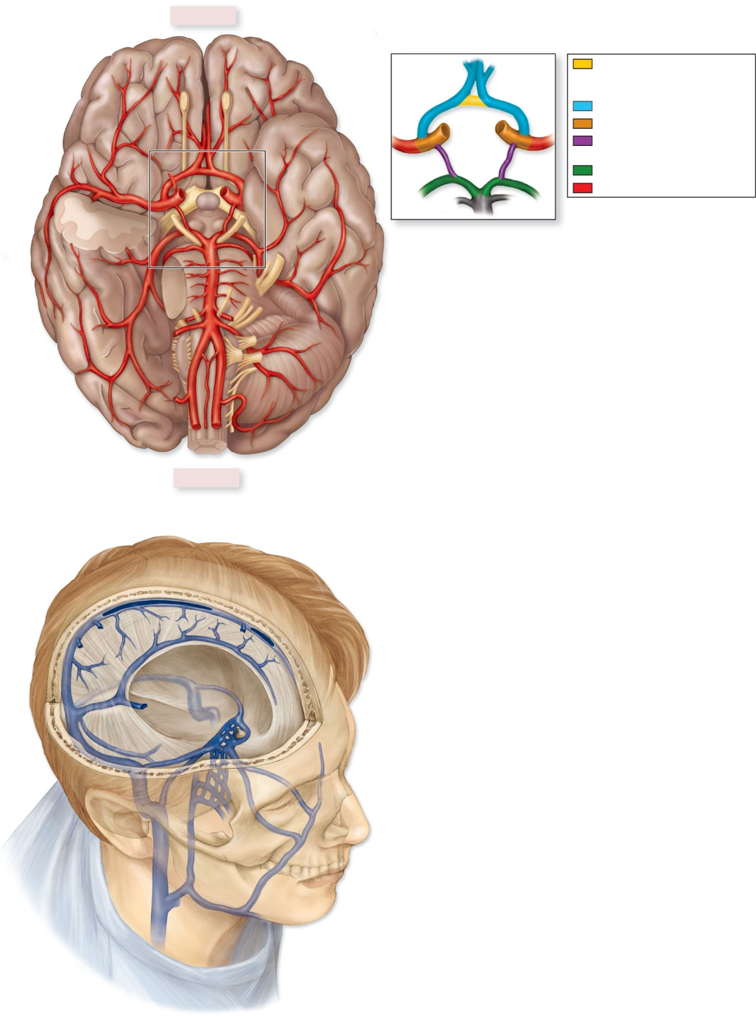
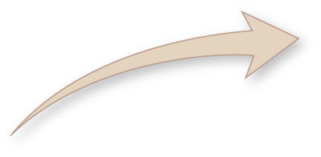
Anterior
Internal carotid artery
Anterior communicating artery
(connects right and left anterior
cerebral arteries)
Anterior cerebral artery
Anterior cerebral arteries (R/L)
Ophthalmic artery
Internal carotid artery (R/L)
Middle cerebral artery
Posterior communicating
arteries (R/L)
Posterior cerebral arteries (R/L)
Middle cerebral arteries
Cerebral arterial circle
(circle of Willis)
Posterior cerebral artery
Basilar artery
Vertebral artery
Posterior
(a) Arteries of the brain, inferior view
Superior sagittal sinus
Inferior sagittal sinus
Internal jugular vein
Venous drainage of cranium, right superior anterolateral view

Slide 63
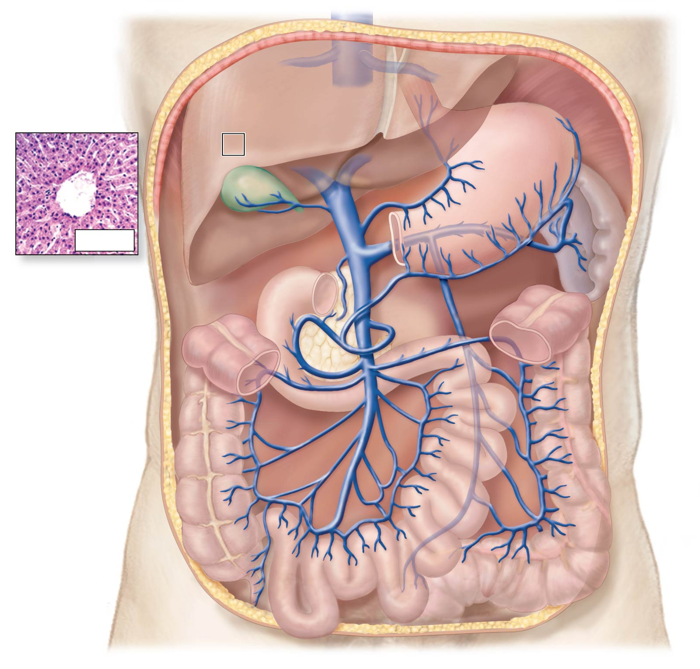
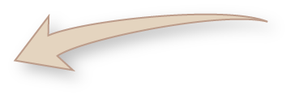
Inferior vena cava
Diaphragm
Hepatic veins
Liver
Sinusoid
(processes
blood from
hepatic portal
vein and
hepatic artery)
Stomach
Spleen
LM 30x
Hepatic portal vein
Duodenum
Pancreas (cut)
Superior mesenteric vein
Blood flow
Ascending colon
Descending colon
Small intestine
(inset): © Victor P. Eroschenko

Slide 64
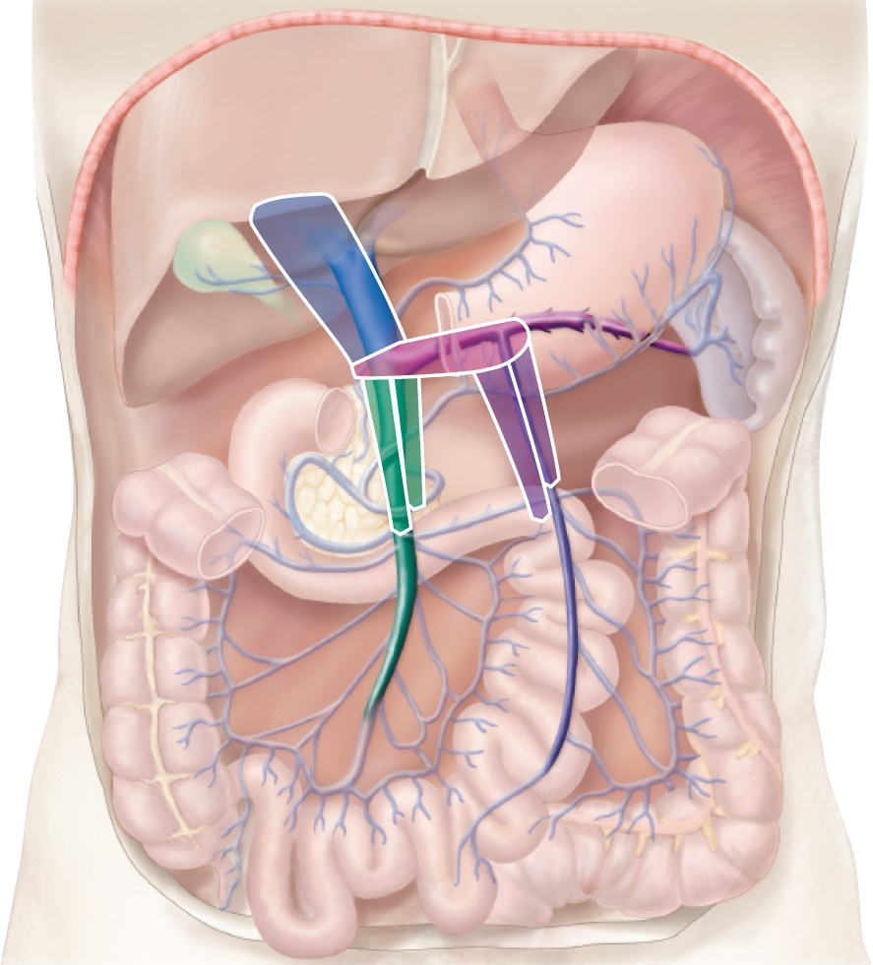
Hepatic
portal vein
Splenic vein
Inferior
mesenteric vein
Superior
mesenteric vein
The configuration of the veins of the hepatic portal system resembles a chair.

